Slide 1
Unit – 6 Database programming

Slide 2
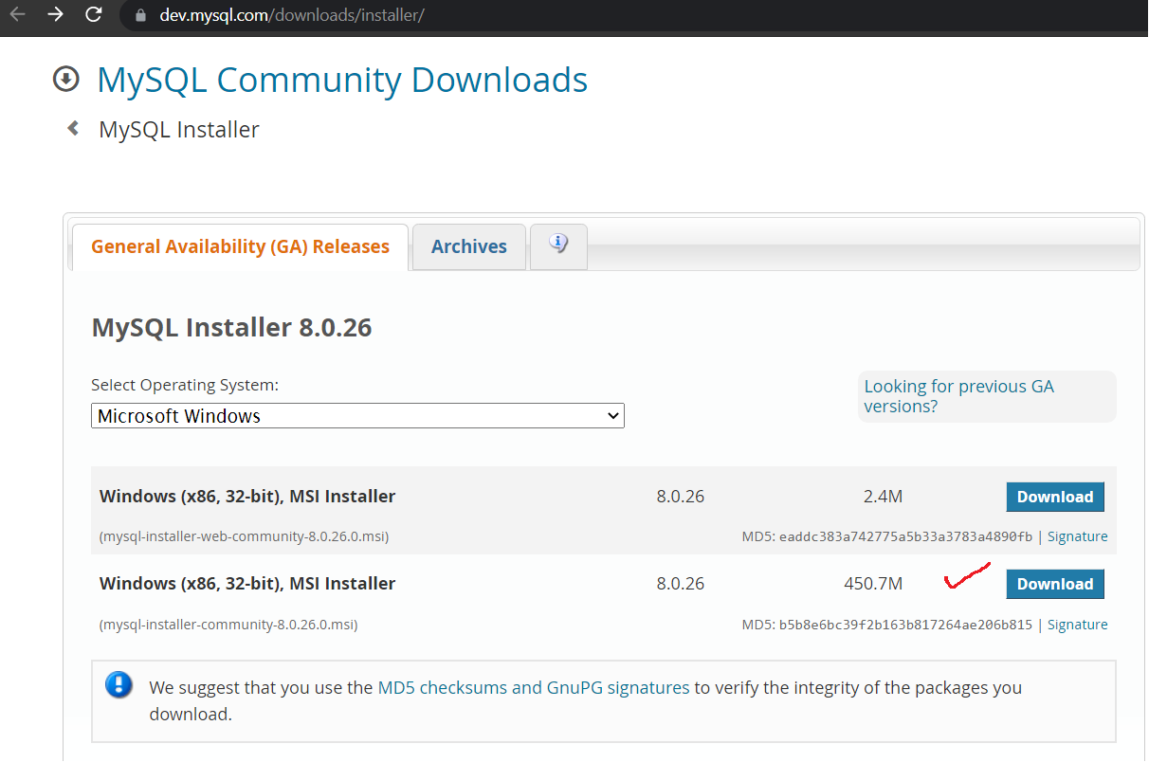
How to install MySQL
Windows:
https://dev.mysql.com/downloads/installer/
Setup
Default steps
Router setup not needed (ignore)
Credentials:
root : mysql
Port: 3306
Host: localhost

Slide 3
Install driver
Open anaconda command prompt
pip install mysql-connector-python

Slide 4
How to establish connection?
from mysql.connector import connect, Error
try:
con = connect(
host="localhost",
user="root",
password="mysql"
)
print(connection)
except Error as e:
print(e)

Slide 5
How to establish connection?
from getpass import getpass
from mysql.connector import connect, Error
try:
with connect(
host="localhost",
user="root"),
password="mysql"),
) as con:
print(con)
except Error as e:
print(e)

Slide 6
How to establish connection?
from getpass import getpass
from mysql.connector import connect, Error
try:
with connect(
host="localhost",
user=input("Enter username: "),
password=getpass("Enter password: "),
) as con:
print(con)
except Error as e:
print(e)

Slide 7
How to create a database?
from mysql.connector import connect, Error
try:
con = mysql.connector.connect(host="localhost",user="root",password="mysql")
except Error as e:
print(e)
else:
cursor = con.cursor()
cursor.execute("CREATE DATABASE db1")
print("cursor = ",cursor)
cursor.close()
con.close()

Slide 8
Check if Database Exists
from mysql.connector import connect, Error
try:
con = connect(host="localhost",user="root",password="mysql")
except Error as e:
print(e)
else:
cursor = con.cursor()
cursor.execute("SHOW DATABASES")
for db in cursor:
print(db)
cursor.close()
con.close()

Slide 9
Connect to a specific database
from mysql.connector import connect, Error
try:
con = connect(host="localhost",user="root",password="mysql",database='db1')
except Error as e:
print(e)
else:
cursor = con.cursor()
cursor.execute("SHOW TABLES")
for db in cursor:
print(db)
cursor.close()
con.close()

Slide 10
How to create a table?
from mysql.connector import connect, Error
try:
con = connect(host="localhost",user="root",password="mysql",database='db1')
cursor = con.cursor()
cursor.execute("CREATE TABLE customers (name VARCHAR(255), address VARCHAR(255))")
print("Table customers created.")
cursor.close()
con.close()
except Error as e:
print(e)

Slide 11
How to list tables?
try:
con = connect(host="localhost",user="root",password="mysql",db='db1')
cursor = con.cursor()
cursor.execute("SHOW TABLES")
for tbl in cursor:
print(tbl)
cursor.close()
con.close()
except Error as e:
print(e)

Slide 12
How to insert a row in database table?
try:
con = connect(host="localhost",user="root",password="mysql",database='db1')
cursor = con.cursor()
sql = "INSERT INTO customers (name, address) VALUES ('McGrath', 'Australia')"
cursor.execute(sql)
con.commit()
print("Row inserted into the table customers.")
cursor.close()
con.close()
except Error as e:
print(e)

Slide 13
How to insert a row in database table?
try:
con = connect(host="localhost",user="root",password="mysql",database='db1')
cursor = con.cursor()
sql = "INSERT INTO customers (name, address) VALUES (%s, %s)"
val = ("Joshi", "DDU, Nadiad.")
cursor.execute(sql, val)
con.commit()
print("Row inserted into the table customers.")
cursor.close()
con.close()
except Error as e:
print(e)

Slide 14
How to insert multiple rows?
sql = "INSERT INTO customers (name, address) VALUES (%s, %s)"
val = [
('name1', 'address1'),
('name2', 'address2'),
('name3', 'address3'),
('name4', 'address4'),
('name5', 'address5'),
]
cursor.executemany(sql, val)
con.commit()
print(cursor.rowcount,"rows inserted.")

Slide 15
How to get lastrowid?
sql = "INSERT INTO customers (name, address) VALUES (%s, %s)"
val = ("M S Dhoni", "Ranchi")
cursor.execute(sql, val)
con.commit()
print(cursor.rowcount,"rows inserted. Rowid=",cursor.lastrowid)

Slide 16
Fetching rows
fetchone()
It fetches the next row of a query result set.
A result set is an object
that is returned when a cursor object is used to query a table.
fetchall()
It fetches all the rows in a result set.
If some rows have already been extracted from the result set,
then it retrieves the remaining rows from the result set.
rowcount
This is a read-only attribute
it returns the number of rows that were affected by an execute() method.

Slide 17
References
https://realpython.com/python-mysql/
https://www.datacamp.com/community/tutorials/mysql-python
https://www.w3schools.com/python/python_mysql_getstarted.asp
https://www.tutorialspoint.com/python/python_database_access.htm
https://www.mysqltutorial.org/calling-mysql-stored-procedures-python/

